Slide 1
Web Programming
3 Assignments/Projects
2 Midterms
Multiple unannounced Quizzes (at the start of class)
Assignments/Project (25%)
Midterms (25%)
Quiz (10%)
Final Exam (40%)
80% attendance is required

Slide 2
Lecture 1
Web Programming
Web Architecture
Understanding the Key Components and Best Practices

Slide 3
Objective
Why Web Technology?
Key Components of Web Architecture.
Client-Server Model
System Architecture tiers
Scalability
Microservices Architecture
RESTful Design
Responsive Design
TCP/IP
Uniform Resource Locators (URL)
Hypertext Transfer Protocol (HTTP)
World Wide Web (www)
Security
Use Case

Slide 4
Why Web Technology ?
The internet connects billions of users worldwide. Web technology enables access to information from anywhere, at any time, on any device (PC, tablet, smartphone).
In very short period of time, it has caused major changes in information technology, business processes, communications and the way many people spend their leisure time.
To compare its growth, consider that the World Wide Web attained 50 millions users in four years.
It took radio 38 years and television 13 years to reach similar penetration.

Slide 5
What is Web Architecture?
Web architecture refers to the structure of the underlying technology stack that powers websites and web applications.
It involves planning and designing the layout and interactions of servers, databases, APIs, frontend, and backend technologies.

Slide 6
Key Components of Web Architecture
Frontend: The user interface (UI) and experience (UX).
Backend: Server-side components that process requests, store data, etc.
Database: Storage layer for data.
APIs: Interface for data exchange between systems.
Communication Layer: Protocols like HTTP/HTTPS.

Slide 7
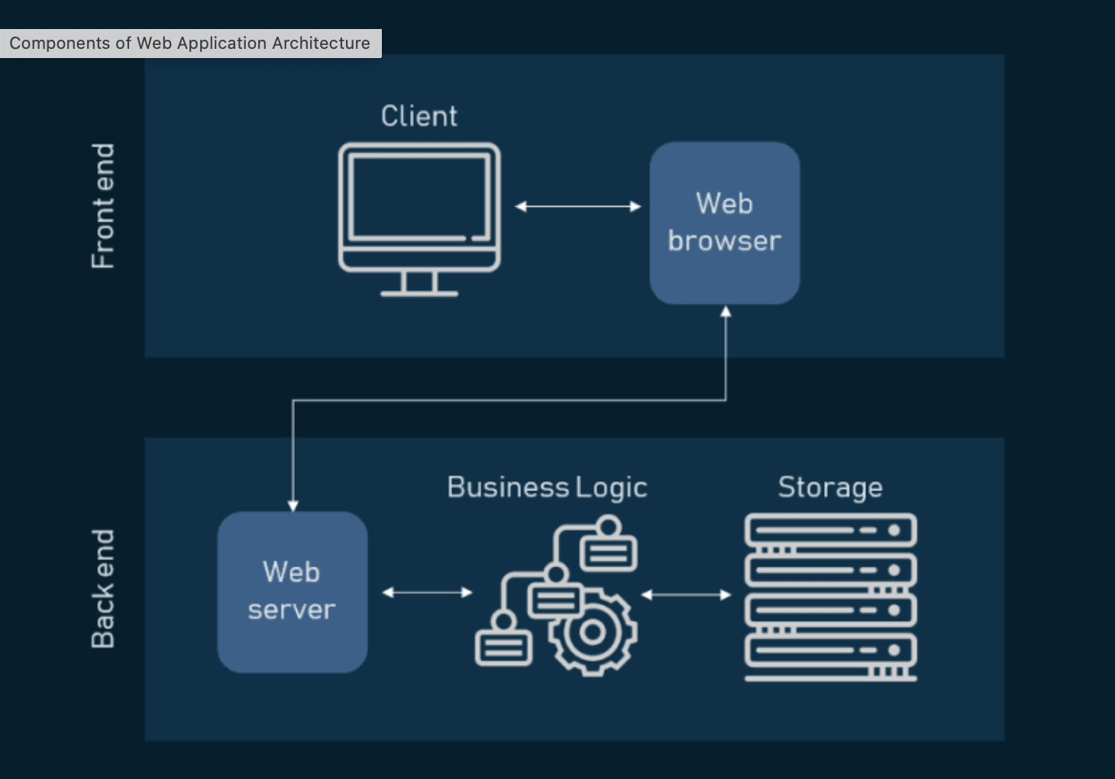
Web Architecture

Slide 8
Client-Server Model
Client-Server model involve the following independent layers:
Presentation - Client – how the user interacts with application. The user's device (browser, mobile app, etc.) requesting resources.
Server – A machine providing data, services, and resources to the client.
Data Storage – Handles the storage and retrieval of data

Slide 9
Two Tier Architecture
A "two-tier architecture" is a type of client-server architecture.
It is a software architecture where an application is divided into two distinct layers: the client tier (user interface) and the data tier (database and application logic). Application logic can either reside in user interface or database.
The client directly communicates with the server to access data and perform operations.

Slide 10
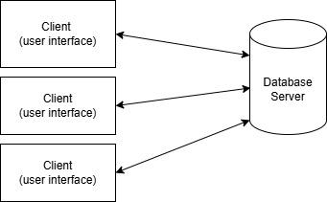
Two Tier Architecture

Slide 11
Three Tier Architecture
A "three-tier architecture" is also a type of client-server architecture.
It is a software architecture where an application is divided into three distinct layers: the client tier (user interface), application layer (application logic) and the data layer (database).
The client directly communicates only with the application layer to access data and perform operations.
https://www.techtarget.com/searchsoftwarequality/definition/3-tier-application

Slide 12
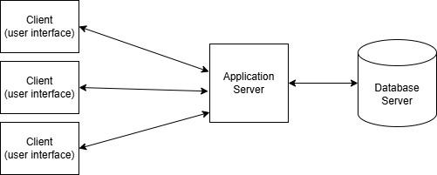
Three Tier Architecture

Slide 13
N-tier Architecture
N-tier architecture divides an application into N number of tiers.
An N-tier architecture can divide a system into 2, 3, 4 or more tiers.
Additional tiers: caching, authentication, etc.

Slide 14
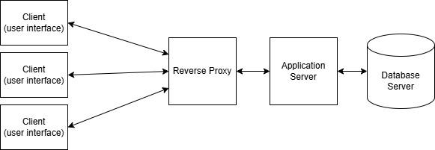
N-tier Architecture
4-tier Architecture

Slide 15
System Architecture
Web Technologies: Centralized Computing
Web Server
Application Server
Database Server
Presentation Layer
(HTML)
Data Access logic
(RDBMS)
Business Logic
Internet
Intranet
Web Browser (Client)
Web Browser
(Client)

Slide 16
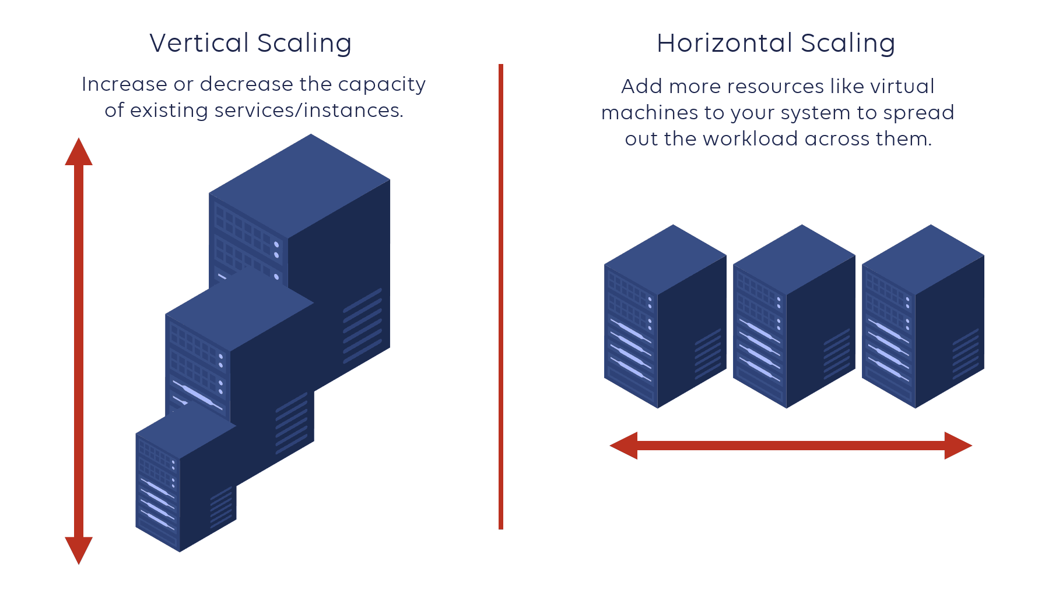
Scalability
Horizontal Scaling (Scaling Out): Adding more servers to handle increased load.
Vertical Scaling (Scaling Up): Increasing the resources (CPU, RAM) of a single server.
Why it matters: As user traffic grows, web systems need to scale efficiently to maintain performance and availability.

Slide 17
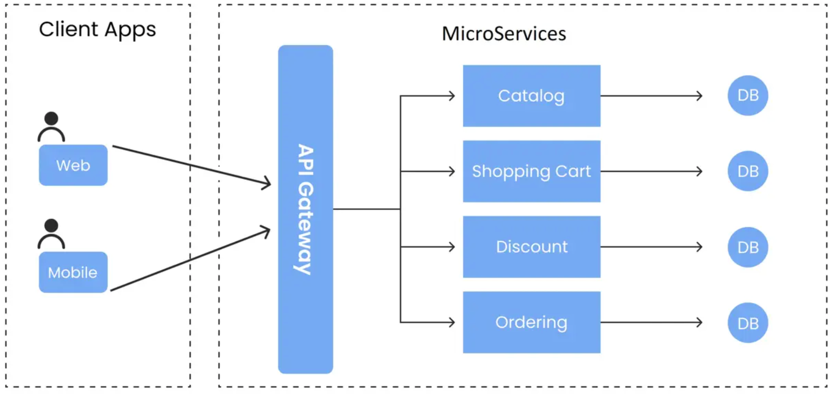
Microservices Architecture
What is Microservices?
Breaking down a large system into smaller, independently deployable services.
Benefits:
Independent scalability and fault isolation.
Easier to maintain and update.
Example: A large e-commerce platform with separate services for user authentication, product catalog, and payment processing.

Slide 18
RESTful Design
What is REST?: Representational State Transfer – an architectural style for designing networked applications.
Principles:
Statelessness: No session data stored on the server.
Uniform Interface: Standardized URL patterns (e.g., /users, /products).
HTTP Methods: Use of GET, POST, PUT, DELETE for CRUD operations.

Slide 19
Responsive Design
Principle: Designing web applications that adapt to different screen sizes and devices.
Tools:
CSS Media Queries: Adjust layout based on viewport size.
Flexible Grid Layouts: Dynamic layout based on content.

Slide 20
Web Technology Fundamentals
TCP/IP Networking
Is a set of rules that govern how data is sent between devices on a network. It's the standard method for communicating on the internet.
It breaks data into packets and send them using different routes and make sure they are reassembled at the destination to form a complete message and are error free.
Internet Protocol – It is used to route a packet of data from node to node across the network.
Transmission Control Protocol – It is used to create a point-to-point communication channel and ensures that the information is delivered error free and in correct order that it was originally transmitted.

Slide 21
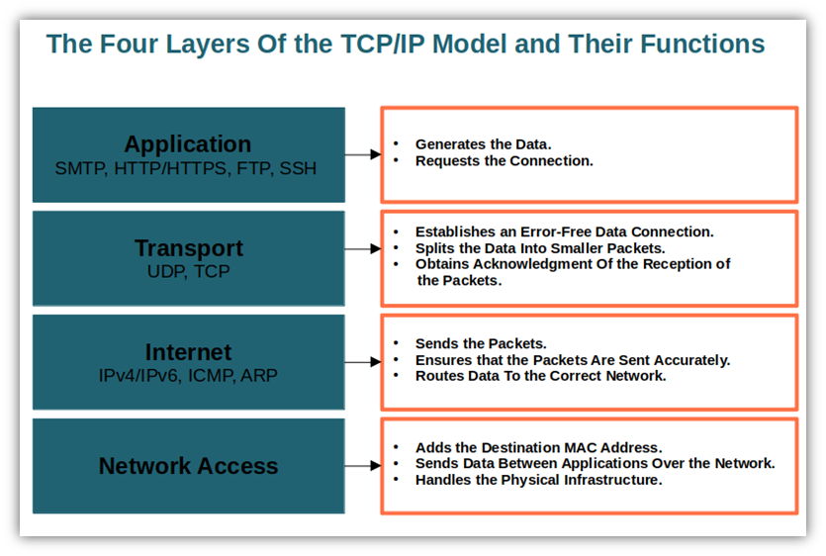
TCP/IP Protocol Stack

Slide 22
Web Technology Fundamentals
Network Addresses
Every computer that is connected to an IP network is uniquely identified by a value, known as its IP address.
Example: 194.27.254.189

Slide 23
Web Technology Fundamentals
Port Numbers – It is used to distinguish between the individual networking applications that are running simultaneously above the TCP/IP protocol stack.
Port Numbers for standard TCP/IP services examples:
80 – Hypertext Transfer Protocol (HTTP) …Web/WWW
21 - File Transfer Protocol (FTP) … File Transfer
Uniform Resource Locator (URL) – All information over the internet can be accessed, using a reference called URL.

Slide 24
Web Technology Fundamentals
Uniform Resource Locator
<protocol> : / / <machine id> / <local name>
<protocol> : identifies the application protocol used to retrieved the source.
<machine id> : identifies the server on which the resource is located.
<local name> identifies the resource, and that can include a directory structure.
Example: https://www.facebook.com/login

Slide 25
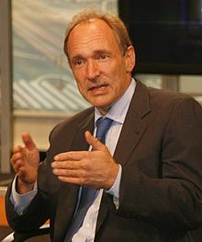
Web Technology Fundamental
The World Wide Web (WWW)
The WWW is NOT the Internet. The Internet is the global network of computers, while the World Wide Web is the content (websites, webpages, media) accessed over the Internet.
Key Components:
Web pages: Documents containing text, images, videos, and links.
Web browsers: Software like Chrome, Firefox, and Safari used to access and navigate the web.
Tim Berners Lee

Slide 26
Security
Secure Transactions: With the adoption of HTTPS (HyperText Transfer Protocol Secure), web technologies provide encryption of data transmitted between the user’s browser and the server. This ensures sensitive information, such as passwords, credit card numbers, and personal details, is securely transmitted, reducing the risk of data breaches.
Authentication and Authorization: Web technologies support advanced security protocols like OAuth, OpenID, and two-factor authentication (2FA), which allow web applications to ensure that users are securely authenticated before granting access to sensitive data or services.
Protection Against Threats: Modern web technologies are also built with security in mind, helping to mitigate risks such as Cross-Site Scripting (XSS), Cross-Site Request Forgery (CSRF), and SQL injection attacks.

Slide 27
Summary
Web architecture is a multi-layered process involving frontend, backend, database, and APIs.
Scalability, security, and performance are critical to the success of any web application.
Modern web systems rely on principles like microservices, RESTful APIs, and responsive design.

Slide 28
Questions
What is the difference between HTTP and HTTPS?
What is the difference between Web App and Desktop App ?
What is the meaning of responsive design?
Can you name an open source framework for building responsive websites?
Advantages of Microservice Architecture?

Slide 29
Thank You!

